Slide 1

Portfolio
LIEW JIA ER
01

Slide 2
About me
EDUCATION
2nd-year student pursuing an IT Diploma at Tunku Abdul Rahman University of Management and Technology (TARUMT)
SKILL LEARNING DURING YEAR 1 - YEAR 2 SEMESTER 1
C Language
HTML
CSS
Java Script
MySQL
PHP
Java
02

Slide 3
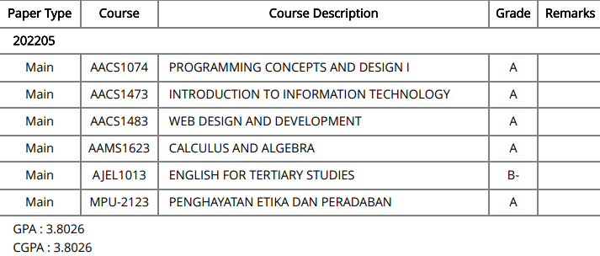
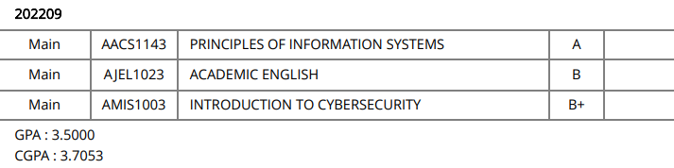
Grade Record
Year 1 Semester 1:
Year 1 Semester 3:
03
Year 1 Semester 2:

Slide 4
My Assignment (1)
04
Title:
Date:
Project Description:
My Task:
Design and build a console-based system using C language.
March 2023 - April 2023 ( Year 1 Semester 3 )
This system encompasses the main functions, which include recording information about customers, employees, and goods, as well as the automatic update of the quantity of goods.
Responsible in Stock Information Module:
Have Add, Delete, Modify, Display, Search and View function in it.
Design a clear format for all function to avoid misunderstanding.
Store the stock information in TXT and connect it with C language.
Connect with Sales module to let the system automatic update the quantity of goods.

Slide 5
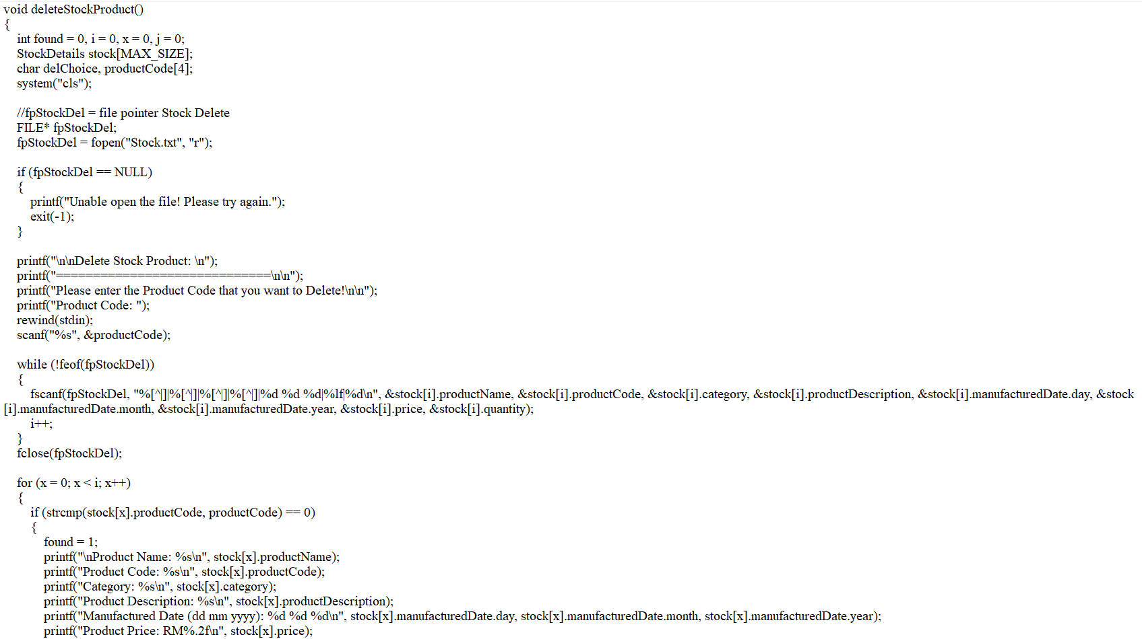
Sample Code (Delete Stock Function)

Slide 6
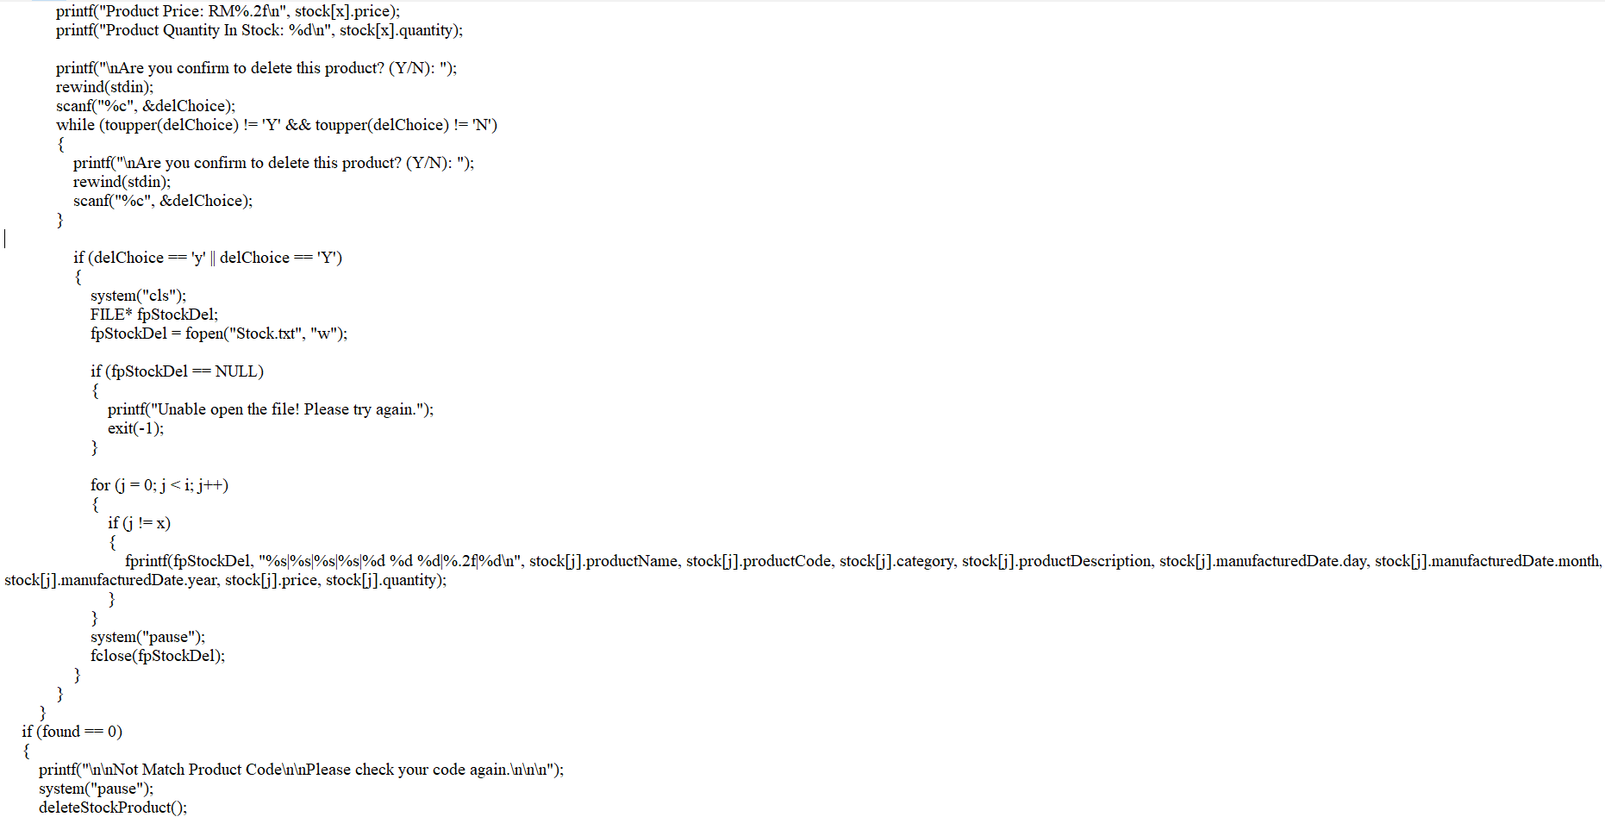

Slide 7
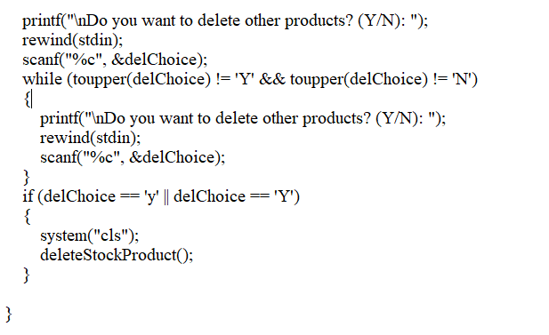
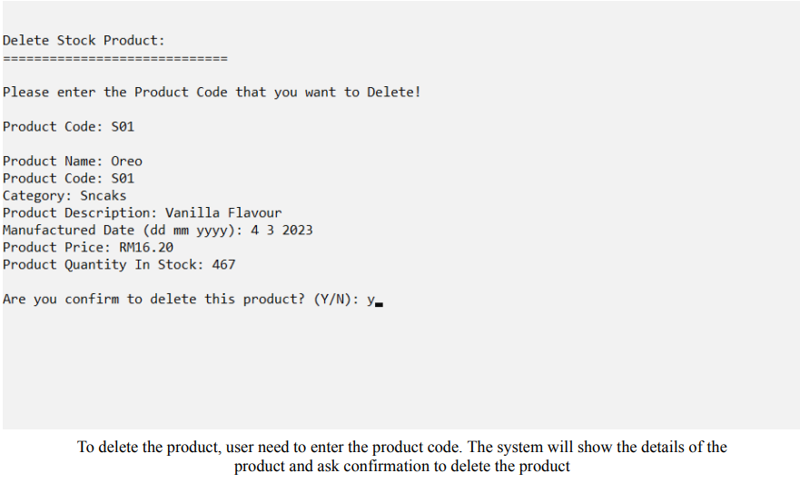
Sample Output:

Slide 8
My Assignment (2)
08
Title:
Date:
Project Description:
My Task:
Create a database for your selected IS system.
March 2023 - April 2023 ( Year 1 Semester 3 )
Our database comprises 11 variables, then produce queries to extract meaningful information for decision making. Therefore, the company was able to make faster decisions, reduce risks, and improve efficiency, better meeting market demands.
Create sample records in the database for 11 variables.
Create database tables in Oracle.
Create three types of multi-table queries to extract useful meaningful information from the database.

Slide 9
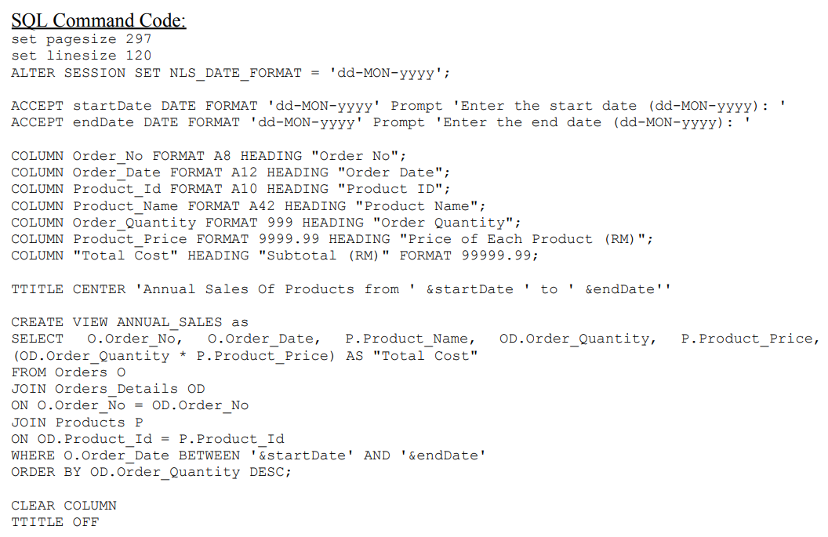
Sample Queries(Annual Sales Of Products)

Slide 10
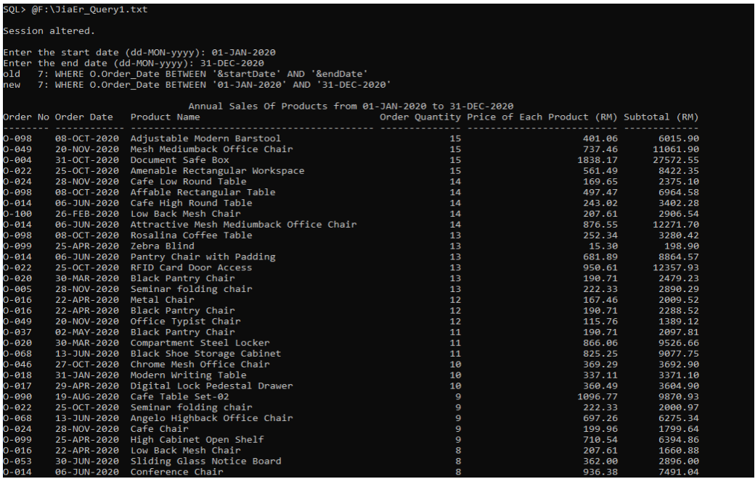
Sample Output

Slide 11
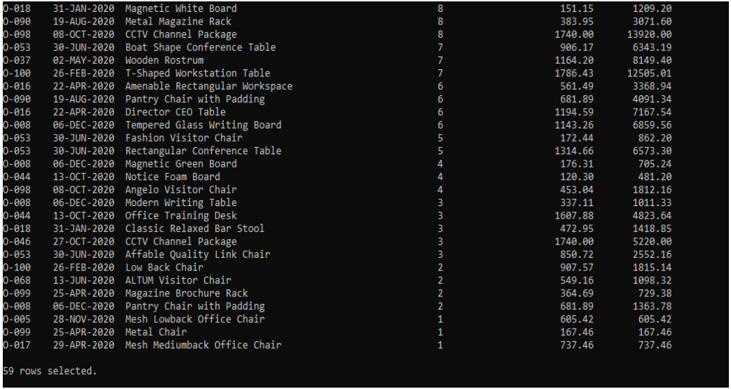

Slide 12

f)(i) What can you contribute to the organisation in 12 weeks.
"I can bring flexibility and adaptability to the organization. Regardless of the specific project I'm assigned to, I will be dedicated to understanding the project's needs and goals and providing support accordingly. My skills and commitment will be utilized to assist the project team in achieving success."

Slide 13
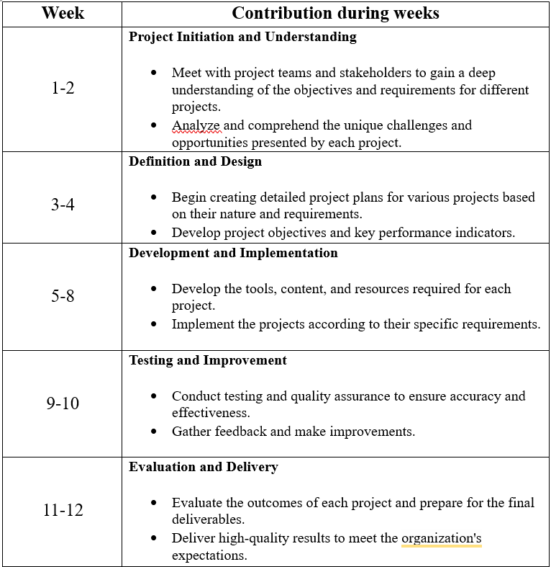
f)(ii) Please prepare details proposal how can you contribute to the organisation in 12 weeks.

Slide 14
f)(iii) How many (quantity) that you can contribute to the organisation in 12 weeks as what you have proposed in f(i)
“The specific quantity of contributions will vary based on the project's needs, but my commitment is to make meaningful contributions within the 12-week timeframe. I aim to deliver high-quality results, which may involve completing tasks, formulating strategies, or delivering outcomes as needed for each project. I will work closely with the project team to ensure that my contributions align with project requirements and the organization's expectations.”

Slide 15

EMAIL
jiaerliew@gmail.com
Contact me
NAME
Liew Jia Er
PHONE
016-6836415

Slide 16

15
THANK YOU

